Slide 1

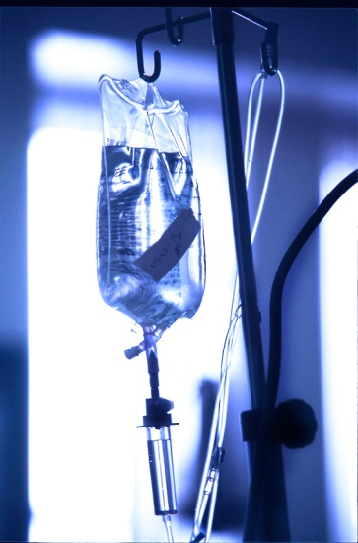
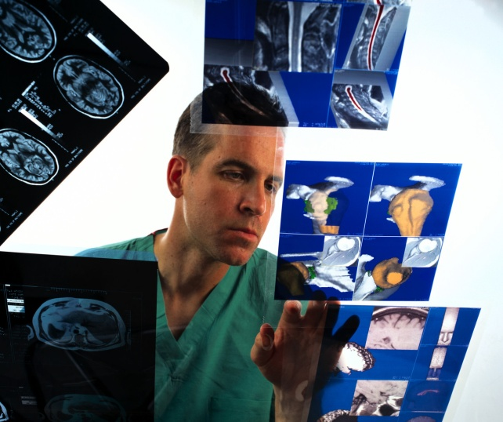
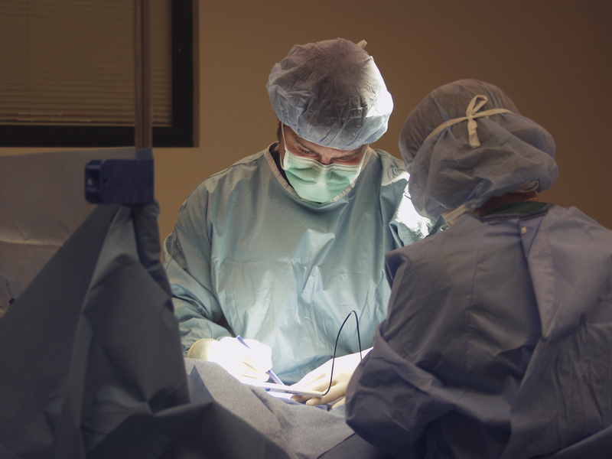

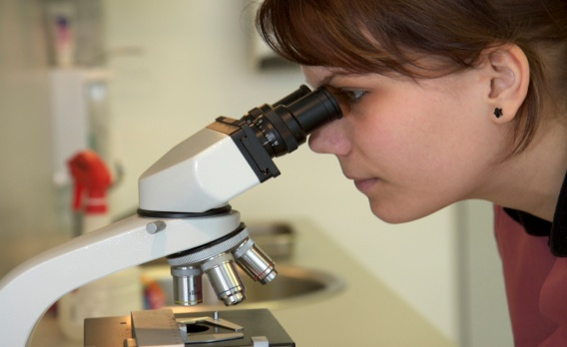


Materials & Logistics Management

Slide 2
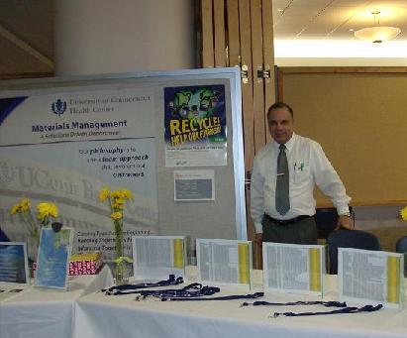
Office of Materials & Supply Chain Management
MISSION STATEMENT
Materials & Logistics Management (MLM) is dedicated to advancing the Health Center’s academic, research and clinical care objectives by providing the Health Center community with expert, efficient, cost effective and compliant supply chain logistics, distribution, inventory, property management, records retention, shipping and receiving services. Working together, we will tap into our collective power and experience to offer a diverse perspective from our various Hospital and Clinical departments, challenge current practices, promote innovative solutions, and advance the University of Connecticut Health Center/John Dempsey Hospital to the next generation of supply chain optimization and savings.
Jack Ferraro
860-679-1927
University Director and
State of Connecticut
RML Officer
Materials, Supply Chain, Property & Resource Management
The Friendship of Those We Serve is the Foundation of Our Progress.
Our philosophy is to use a team approach that involves our customers.

Slide 3
MLM’s Role - What We Do
Transportation – Patient Transportation, Central Shipping/Receiving & Distribution (mail & courier)
Property Administration
  Tag and track capital assets
  Handle moving and storage needs
  Ensure compliance with records retention and destruction requirements
  Oversee electronic waste and degaussing process
  Manage surplus property program
  Manage fleet vehicles & vehicle rental program
Clinical Inventory/Supply Chain – Manage Central Warehouse, clinical inventory formulary and PAR programs
Value Analysis – Partner with clinical leadership and Procurement
Department to reduce costs and improve quality of care through the selection of clinical products
Health Care Industry Representative Badging – Support efforts of Public Safety and Compliance Department to ensure that only authorized individuals are allowed into patient care areas

Slide 4

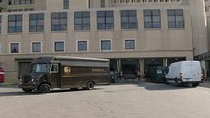

MLM Service Areas
Transportation
Patient Transportation, Central Shipping/Receiving & Distribution
Provide patient transportation and related services for JDH
Provide central shipping and receiving services (including customs and outbound freight)
Sort and meter mail
Provide on-campus and off-campus distribution
and courier services (pick-up and delivery of mail,
packages and supplies)
Distribute clinical PAR inventory
Ensure that materials are received and accounted
for, and that they are distributed in a safe, timely
and efficient manner

Slide 5

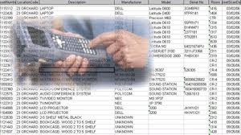
MLM Service Areas
Property Administration/Capital Assets
Update the Health Center’s equipment inventory data file
Reconcile the equipment inventory data file to expenditure information
Conduct physical inventories throughout Health Center as required
New Acquisition Control (tag & inventory)
Loss Reporting

Slide 6
MLM Service Areas
Motor Pool & Fleet Operations
Maintain a fleet of passenger vehicles, vans and trucks to support the business needs of all Health Center departments
  Vehicles are available for daily rental or monthly leases
Manage UCHC’s Central Motor Pool, which allows departments to share the use of state vehicles for business purposes.
  Daily rentals available through the MLM Help Desk.
Special event bus/transportation program to support UCHC’s business needs

Slide 7
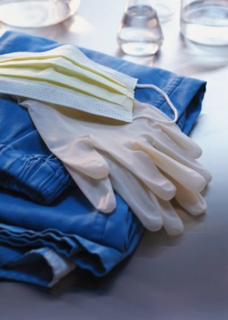
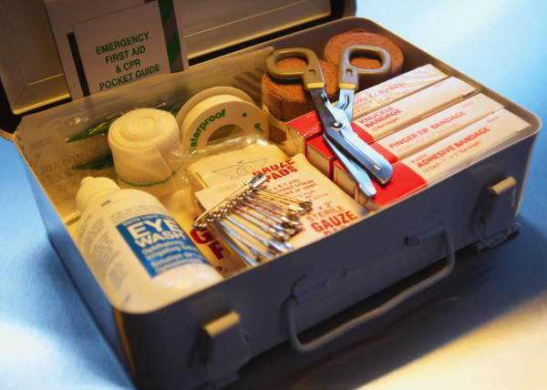
MLM Service Areas
Clinical Inventory & Supply Chain
Ensure proper placement & distribution of all items within the clinical inventory formulary
Maintain & monitor inventories in the hospital & clinical enterprise
Enter Requisitions into HuskyBuy for clinical supplies
Work with clinical leadership and Procurement Department on Value Analysis and the development of product standards for the clinical enterprise
Coordinate the evaluation and trial of new
clinical equipment and supplies

Slide 8
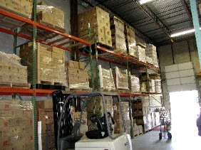
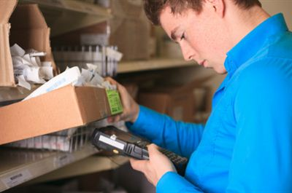
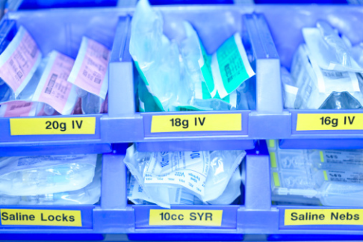
MLM Service Areas
Warehouse Services
Provide short- and long-term warehouse
storage
Manage central inventory
Coordinate the surplus supply and equipment
credit/exchange and disposal programs
PAR inventory for JDH, UMG, SODM & CMHC
Provide on-site records storage (for records
that are required to be retained on site)

Slide 9
Requesting New Clinical Products & Equipment
Requests for clinical products or equipment not already being used at UCHC require additional review and approval for:
  Compatibility with UCHC’s current clinical products, equipment & systems
  Safety/effectiveness of item and regulatory approvals for use
  Staff training required
  Financial viability – total cost of item requested including cost of consumables and peripherals, reimbursement eligibility, impact on UCHC’s product standardization program
The new item may need to be trialed before it can be approved.
For supplies/equipment used in a clinical setting:
  The new item must be reviewed and approved by one of our Clinical Value Analysis committees
  The Procurement Department investigates potential sourcing for the new item – what suppliers sell it, and at what price?
  Materials & Logistics Management handles the financial analysis and coordinates trials of the new item
Once all approvals to purchase it have been obtained, the Procurement Department will work with the requesting department to source the item (through a bid, GPO or sole source process).

Slide 10
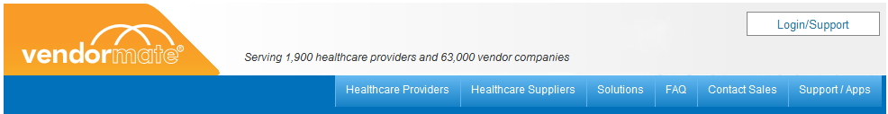
Health Care Industry Representative Registration
Healthcare Industry Representative Notice
Dear Healthcare Industry Representative,
We are committed to providing the best patient care available to our patients. As a healthcare industry representative, you are an integral part of this process and it is a priority of ours to ensure that we, and our vendors, are compliant with hospital policy and industry standards.
The University of Connecticut Health Center/John Dempsey Hospital is requiring that you provide documentation that you will abide by our standards for environmental health, safety, privacy and quality.
In order to assist our hospital with credentialing all vendor representatives in the most efficient way, we have partnered with Vendormate (www.uchc.vendormate.com). Vendormate provides an internet based service that will allow our vendors and hospital departments to navigate our compliance goals in an efficient, easy and comprehensive manner. Please go to www.uchc.vendormate.com, register, and begin completing your profile and submitting the required compliance documentation for our review. If you have already registered with Vendormate due to your working relationship with other hospitals, you do not need to register again. However, you do need to log-in to your account and ensure compliance with The University of Connecticut Health Center/John Dempsey Hospital policies, by selecting the respective facility and submitting the appropriate documents. …

Slide 11
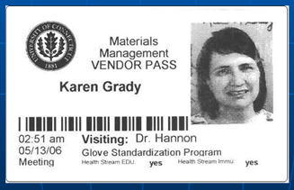
Health Care Industry Representative Registration
Hall Pass Assigned to Vendor Representative
Hall Pass includes a picture of the vendor along with the date, time, vendor name, UCHC Logo, and the department, contact or physician they are there to see that day. Badge also is time expiring; after 12+ hours the badge becomes invalid and is visibly “Expired”, showing a red stop sign.

Slide 12
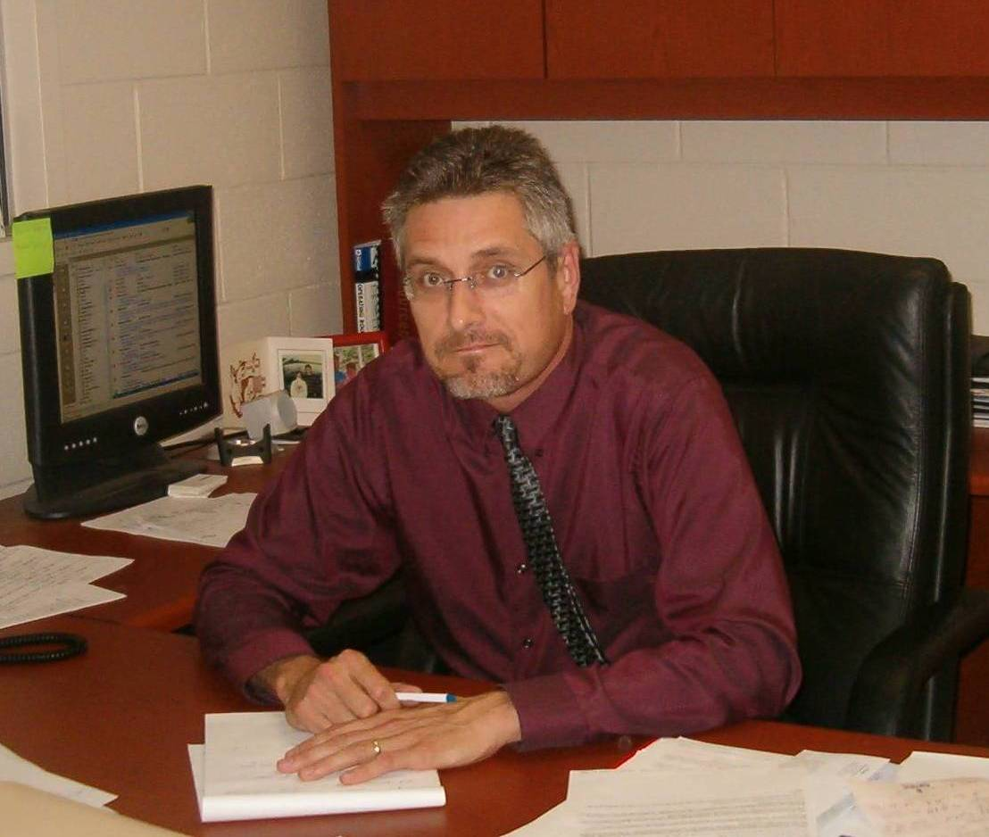
Materials & Supply Chain Team
Jack Ferraro - x1927
University Director and State of Connecticut Records Management Liaison Officer
Jeff Boyko - x1955
Assistant Director and Business/Finance Manager
Property & Materials Mgmt
Capital Assets
Moving & Storage
Records Storage
Surplus Property
Transportation
UCHC Fleet Operations
Business & Finance Services
Clinical Supply Chain
Supply Chain Management
Warehousing
Inventory Control

Slide 13
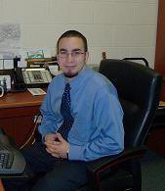
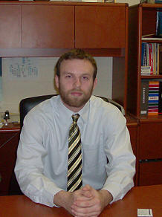
Materials & Supply Chain Team
Adam Mike - x3255
Materials Logistics Supervisor
Central Warehouse Services
JDH, UMG & CMHC PAR Program (for all clinical & non-clinical supplies that are on PAR)
MACOLA/e-Portal/Barcode Apps
Code Carts
Q-Sight
Cardiac Cath Lab
EP Lab
Radiology
Suture & Endo
Alex Schwarz - x1942
Materials Transportation Supervisor
Patient Transportation
Central Shipping & Receiving (including desktop shipping)
Central Distribution (mail & courier)
Demurrage Services (gas cylinders)
Filtered Water Cooler Services

Slide 14
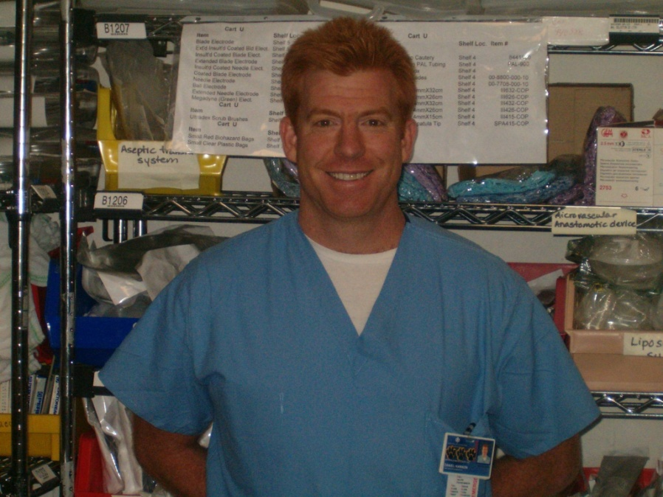
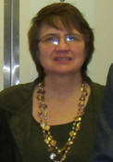
Materials & Supply Chain Team
Dan Hannon - x2740
Medical Materials Supervisor &
Clinical Supply Chain Liaison
Providing Clinical Materials Expertise and Support
Serving John Dempsey Hospital: CSS, Equipment Storage Services, OR, FSC, Transportation
Karen Grady - x2283
Materials Supply Chain & Resource Supervisor
Materials Supply Chain & Resource Management
Central Help Desk Services
Resource Services: JDH/UMG/OCME Requisitioning
(e-Portal/SIS/HuskyBuy), Badging/Hall Pass Program, Inventory Services, JDH Clinical Laboratory Supplies, CMHC Supply Inventory Services, UMG Clinical Supplies, Medical & Surgical Supplies, Housekeeping Supplies, Non-Hazardous Chemical Supplies, Clinical Forms & Business Supplies
Analytical Services: MLM, UMG Clinics, CMHC, Hospital, Pharmacy & OCME

Slide 15
MLM On-Line Resources
On the MLM Website, you can access…
Forms required for:
  Move Requests (MM-1)
  Surplus Property/Equipment Removal Requests (MM-2)
  New Product/Implantable Device Request (MM-7 & MM-12)
  Product Returns (MM-17)
  Use of Fleet Vehicles (MM-11 & MM-11C)
  Records Disposition Authorization Form (RC-108)
Warehouse Catalogs
E-Portal On-Line System
  Clinical products standardized by JDH, Pharmacy, UMG Clinics, Dental, CMHC and OCME are available through the e-Portal on-line ordering system

Slide 16
Materials & Logistics Management
Contact Info
Help Desk – Central Distribution Services (West Dock): x1958
Help Desk – Central Warehouse Services: x1965
Help Desk – Capital Assets, Inventory Control: x1952

Slide 17
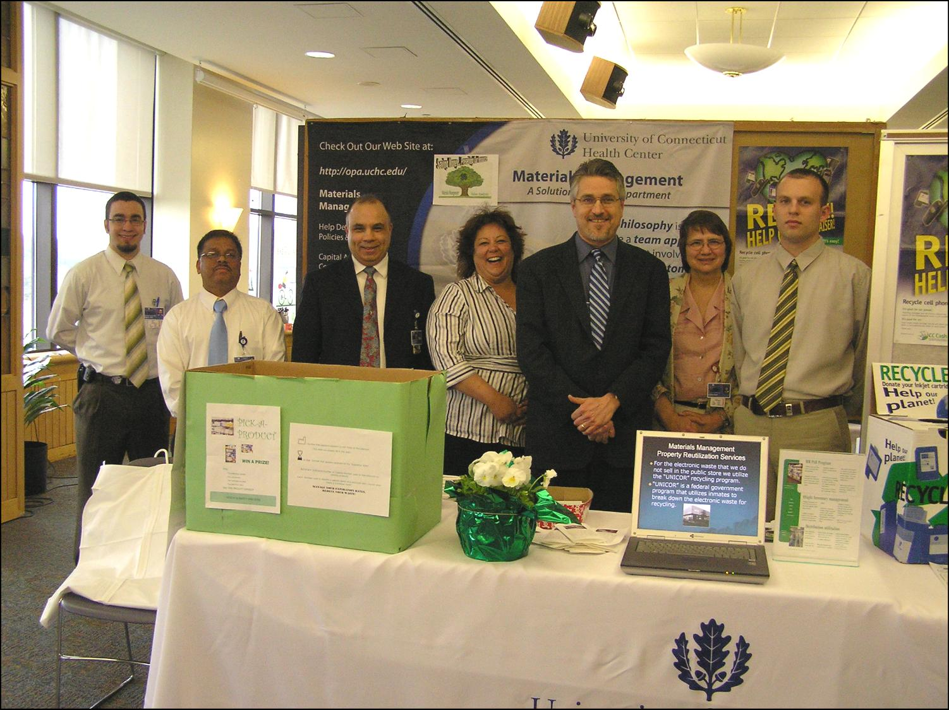
Thank You!
Materials & Resource Management

